Slide 1
System Design: Maintainability, Consistency, Fault Tolerance, Latency, Throughput
System Design(SD)(22CS024)
Bachelor of Engineering- Computer Science & Engineering
Department of Computer Science & Engineering
Chitkara University Institute of Engineering and Technology, Chitkara University, Punjab, India

Slide 2
Maintainability
Maintainability in system design refers to how easily a software system can be modified, updated, and extended over its lifespan.
It's a crucial characteristic that ensures a system can adapt to changing requirements, fix bugs, and improve performance without significant disruption or cost.
Good maintainability reduces long-term costs, minimizes the risk of introducing errors, and makes it easier for developers to understand, troubleshoot, and enhance the system.
Notes:
In system design, availability, reliability, and scalability are crucial characteristics that determine how well a system can handle user demands and adapt to changing conditions. Availability ensures the system is accessible when needed, reliability guarantees consistent and correct performance, and scalability allows the system to handle increasing workloads.

Slide 3
Key Aspects of Maintainability:
Modularity
Readability
Testability
Documentation

Slide 4
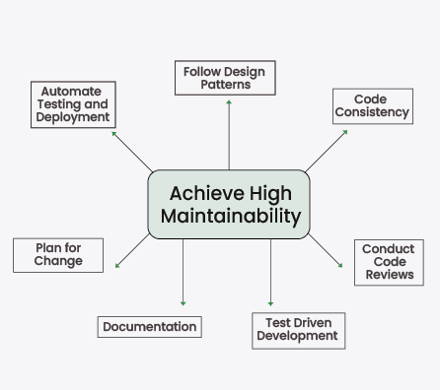
How to achieve high Maintainability

Slide 5
Key Aspects of Maintainability:
Modularity:
Breaking down the system into independent modules with well-defined interfaces makes it easier to modify or replace individual components without affecting the rest of the system.
Design the system with a modular structure, where components are logically separated and have well-defined interfaces.
This allows for independent development and modification of modules, making it easier to understand, test, and maintain specific parts of the system without impacting others.
Readability:
Writing clear, concise, and well-documented code using consistent conventions makes it easier for developers to understand and work with the code.

Slide 6
Testability:
Designing the system to support thorough testing (unit, integration, and automated) allows for quick identification and resolution of issues during modifications.
Documentation:
Comprehensive and up-to-date documentation (design documents, API references, etc.) is essential for developers to understand the system's functionality and how to interact with it.
Notes:
Reliability refers to a system’s ability to perform its intended functions consistently and accurately without failure. A reliable system ensures that users get the expected results every time they interact with your application.

Slide 7
Why Maintainability is Important
Reduced Costs:
Easier maintenance translates to lower long-term development and operational costs.
Faster Development Cycles:
Modifying a maintainable system is quicker and more efficient, leading to faster feature delivery and bug fixes.
Improved Reliability:
Well-maintained systems are more likely to be reliable because changes are less likely to introduce new errors.
Adaptability:
A maintainable system can adapt to evolving business needs and technological advancements, ensuring its longevity.

Slide 8
Consistency
Consistency ensures data accuracy across different parts of a system.
Definition:
Consistency refers to the guarantee that all users see the same, up-to-date data, regardless of which part of the system they interact with.
Types:
Strong Consistency: Data is immediately consistent after a write operation.
Eventual Consistency: Data will eventually become consistent, but there might be a delay after a write operation.
Importance:
Ensures data integrity and a reliable user experience, especially in applications like banking or e-commerce.
Example:
If a user updates their profile on one server, strong consistency ensures that the updated information is immediately available on all other servers.

Slide 9
Fault Tolerance
Fault tolerance in system design refers to a system's ability to continue operating correctly even when one or more of its components fail.
This is achieved by designing systems with redundancy and mechanisms for detecting, isolating, and recovering from failures.
Essentially, it's about building systems that can withstand component failures without disrupting their overall functionality.
Fault tolerance refers to a system's capacity to keep working even in the face of hardware or software issues.

Slide 10
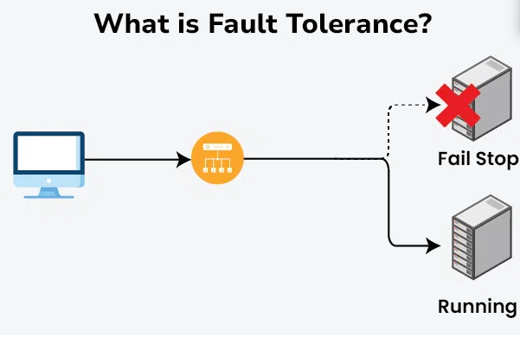

Slide 11
Redundancy, error detection, and error recovery techniques must be used to avoid a costly failure .
This will allow the system to continue operating or deteriorate in performance at a slower rate.
Reducing the impact of errors and maintaining a stable and accessible service even in the face of disruptions are the objectives.

Slide 12
Why is fault tolerance important?
High Availability:
Fault-tolerant systems are crucial for achieving high availability, ensuring that systems remain operational and accessible to users even during failures.
Business Continuity:
For businesses, especially those relying on critical applications, fault tolerance helps prevent disruptions and ensures business continuity.
Safety:
In systems where failure could have serious consequences (like air traffic control or medical equipment), fault tolerance is paramount for safety.

Slide 13
Situations where fault tolerance is crucial
RAID (Redundant Array of Independent Disks): In storage systems, distribute data across multiple disks with redundancy, allowing the system to continue functioning even if one disk fails.
Load Balancing: Distributing network traffic across multiple servers ensures that if one server fails, others can still handle the load.
Clustering: Creating clusters of servers ensures that if one server fails, another can take over the workload seamlessly.
Virtualization: Running virtual machines on a server allows for easy migration of workloads to another server in case of hardware failure.
Microservices Architecture: Breaking down applications into smaller, independent services allows for the isolation of faults, preventing the entire system from failing if one service encounters issues.
Distributed Cloud Architecture: Distributing applications across multiple cloud regions or providers enhances fault tolerance by reducing the impact of a failure in a specific region or service.

Slide 14
Challenges in Implementing Fault Tolerance
Scalability Issues:
Scalability refers to the ability of a system to handle increasing workload or data size gracefully without sacrificing performance or availability.
Scalability challenges in fault tolerance involve ensuring that fault-tolerant mechanisms can scale alongside the system's growth.
Performance Impacts:
Fault tolerance mechanisms, such as redundancy and error correction, can impact system performance.
This challenge involves minimizing performance degradation while maintaining high fault tolerance.
Cost Considerations:
Implementing robust fault tolerance strategies often incurs additional costs due to the need for redundant hardware, software licenses, maintenance, and monitoring systems.

Slide 15
Examples of Fault Tolerance Techniques:
Replication:
Creating multiple copies of data or services across different locations or nodes. If one copy fails, others are available.
Load Balancing:
Distributing traffic across multiple servers to prevent any single server from being overwhelmed and becoming a point of failure.
Check pointing and Rollback:
Saving the system's state at regular intervals (checkpoints) so that it can be rolled back to a consistent state in case of a failure.
Consensus Algorithms:
Used in distributed systems to ensure that all nodes agree on the system's state, even if some nodes fail.

Slide 16
Latency
Latency refers to the time it takes for a request to travel from its point of origin to its destination and receive a response.
Latency represents the delay between an action and its corresponding reaction.
It can be measured in various units like seconds, milliseconds, and nanoseconds depending on the system and application.

Slide 17
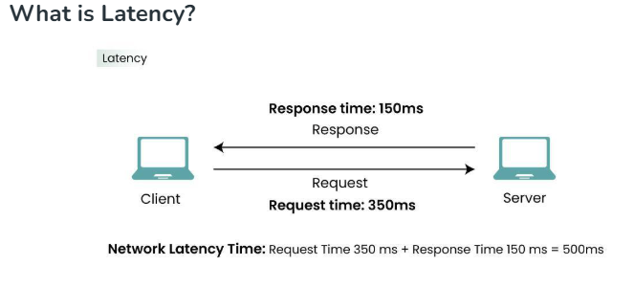

Slide 18
How does Latency works?
The time taken for each step—transmitting the action, server processing, transmitting the response, and updating your screen—contributes to the overall latency.
Example: Let see an example when player in an online game firing a weapon.
If your latency is high: You press "fire."
The command travels through the internet to the server, which takes time.
The server processes the shot.
The result travels back to your device.
Your screen updates the result.
During this time, another player might have moved or shot you, but their actions haven't reached your device yet due to latency. This can result in what's called "shot registration delay." Your actions feel less immediate, and you might see inconsistencies between what you're seeing and what's happening in the game world.

Slide 19
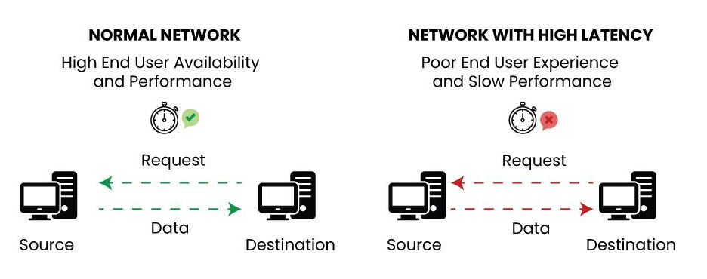
The working of Latency can be understood by two ways:
Network Latency: In system architecture, network latency is a sort of latency that describes how long it takes for data to move between two points in a network.
System Latency : System latency refers to the overall time it takes for a request to go from its origin in the system to its destination and receive a response.

Slide 20
Throughput and Latency: How They Work Together
Throughput refers to the amount of data processed by the system in a given amount of time.
Think of it as the speed at which work is done.
For example, if a system can handle 1,000 requests per second, its throughput is 1,000 requests/second.
Latency is the time it takes for a request to travel from the client to the server and back. It’s like the delay you experience before you see the results of your action.
For instance, if you click a button on a website and it takes 2 seconds for the page to load, that’s the latency.

Slide 21
What is Throughput?
The rate at which a system, process, or network can move data or carry out operations in a particular period of time is referred to as throughput. Bits per second (bps), bytes per second, transactions per second, etc. are common units of measurement.
It is computed by dividing the total number of operations or objects executed by the time taken.
For example, an ice-cream factory produces 50 ice-creams in an hour so the throughput of the factory is 50 ice-creams/hour.

Slide 22
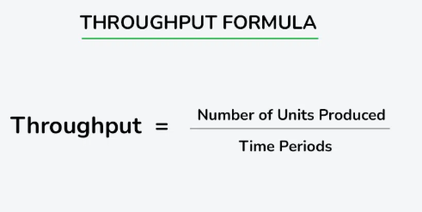

Slide 23
contexts in which throughput is commonly used:
Network Throughput: Throughput in networking is the quantity of data that can be sent via a network in a specific amount of time. When assessing the effectiveness of communication routes, this measure is important.
Disk Throughput: In storage systems, throughput measures how quickly data can be read from or written to a storage device, usually expressed in terms of bytes per second.
Processing Throughput: In computing, especially in the context of CPUs or processors, throughput is the number of operations completed in a unit of time. It could refer to the number of instructions executed per second.

Slide 24
Factors affecting Throughput
Network Congestion
Bandwidth Limitations
Hardware Performance
Software Efficiency
Latency

Slide 25
Methods to improve Throughput
Network Optimization:
Utilize efficient network protocols to minimize overhead.
Optimize routing algorithms to reduce latency and packet loss.
2: Load Balancing:
1. Distribute network traffic evenly across multiple servers or paths.
Prevents resource overutilization on specific nodes, improving overall throughput.
Hardware Upgrades:
1. Upgrade network devices, such as routers, switches, and NICs, to higher-performing models.
2. Ensure that servers and storage devices meet the demands of the workload.

Slide 26
Software Optimization:
1. Optimize algorithms and code to reduce processing time.
2. Minimize unnecessary computations and improve code efficiency.
Compression Techniques:
1. Use data compression to reduce the amount of data transmitted over the network.
2. Decreases the time required for data transfer, improving throughput.
Caching Strategies:
1. Implement caching mechanisms to store and retrieve frequently used data locally.
2. Reduces the need to fetch data from slower external sources, improving response times and throughput.

Slide 27
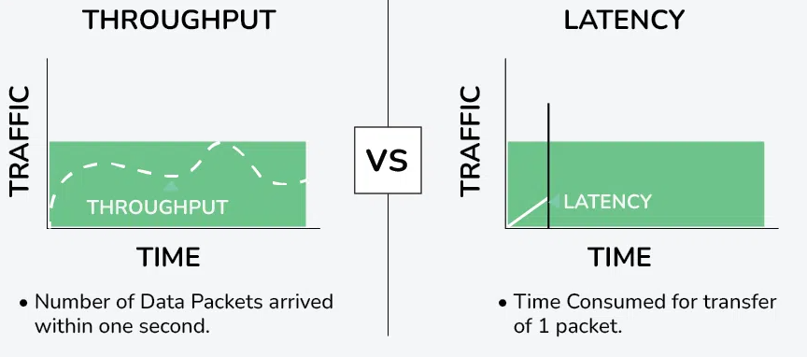
Differences between Throughput and Latency (Throughput vs. Latency)

Slide 28
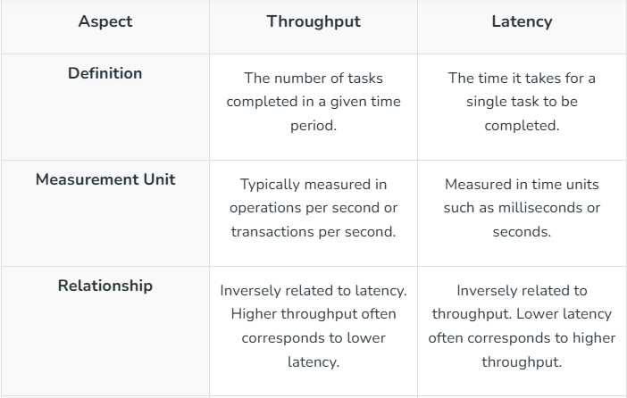

Slide 29
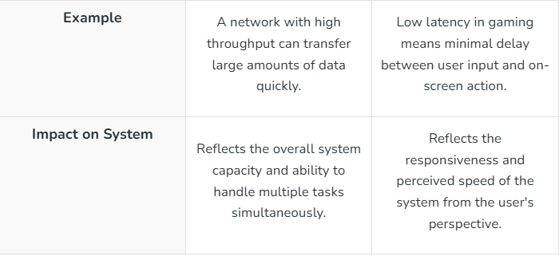

Slide 30
Performance vs Scalability
Performance vs Scalability in System Design explores how systems balance speed (performance) and ability to handle growth (scalability). Imagine a race car (performance) and a bus (scalability). The car zooms quickly but can't carry many passengers, while the bus carries lots but moves slower.
Similarly, in tech, a system may be super fast but crash with too many users (like the car), or handle many users but slow down (like the bus).
Designing systems requires finding the right balance that is, fast enough for current needs, yet flexible to grow with demand.
What is Performance?
Performance in system design refers to how well a system executes tasks or processes within a given timeframe. It encompasses factors like speed, responsiveness, throughput, and resource utilization.
For instance, a high-performance system might process a large amount of data quickly, respond to user inputs rapidly, and efficiently utilize system resources such as CPU, memory, and network bandwidth.
Performance optimization involves techniques such as code optimization, caching, load balancing, and hardware upgrades to ensure that a system meets its performance requirements and delivers a smooth user experience.

Slide 31
Performance Optimization Techniques
Performance optimization techniques in system design involve various strategies aimed at improving the speed, efficiency, and resource utilization of a system. Some common techniques include:
Code optimization:
Refining algorithms and code structures to minimize execution time and resource consumption. This can involve eliminating redundant operations, reducing algorithmic complexity, and optimizing loops and data structures.
Caching:
Storing frequently accessed data or computed results in fast-access memory (cache) to reduce the need for repeated computations or database queries. Caching can significantly improve response times for frequently requested data.
Load balancing:
Distributing incoming requests or tasks evenly across multiple servers or resources to prevent overloading any single component. Load balancers can dynamically adjust resource allocation based on current demand to optimize performance.
Parallelism and concurrency:
Leveraging multiple threads or processes to execute tasks simultaneously, thereby utilizing available resources more efficiently and reducing overall processing time. Techniques such as parallel processing, asynchronous programming, and multi-threading can enhance system performance.
Database optimization:
Optimizing database queries, indexing, and schema design to improve data retrieval speed and reduce latency. Techniques like query optimization, index optimization, and denormalization can enhance database performance.
Resource pooling and reuse:
Reusing existing resources, connections, or objects rather than creating new ones for each request, reducing overhead and improving efficiency. Techniques like connection pooling in database connections or object pooling in object-oriented programming can help conserve resources.

Slide 32
Performance vs. Scalability
Aspect | Performance | Scalability
Definition | Focuses on optimizing speed and responsiveness | Focuses on handling increasing workload or users
Goal | Achieve maximum efficiency for current tasks | Accommodate growing demands without slowdown
Concerns | Speed, latency, throughput, resource utilization | Capacity, availability, distribution of workload
Key Techniques | Code optimization, caching, load balancing | Horizontal scaling, stateless architecture, microservices
Scaling Approach | Vertical scaling (scaling up) | Horizontal scaling (scaling out)
Impact of Growth | May degrade with increased workload | Maintains performance with increased workload
Resource Allocation | May require hardware upgrades for improvement | Adds more instances or nodes for improvement
Maintenance Complexity | Generally lower complexity | May involve higher complexity due to distributed nature
Example | A high-performance gaming server | A scalable social media platform

Slide 33
LATENCY
Problem Statement:
Calculate the round-trip time (RTT) latency for a data packet traveling between a client in New York City and a server in London, UK, assuming a direct fiber-optic connection with a propagation speed of 200,000 km/s.
Distance: Distance between NYC and London: 5570 km
Propagation speed: 200,000 km/s
Constraints: Assume no network congestion or processing delays.
Desired Output: RTT latency in milliseconds.
1. Calculate One-Way Latency: One-way latency is the time taken for the data to travel from the client to the server:
One-way latency = Distance / Propagation speed = 5570 KM / 200,000 Km/s = 27.85 ms
2. Calculate RTT: The RTT is twice the one-way latency:
RTT = 2 × 27.85ms = 55.7ms

Slide 34
Benefits of Consistency
Data Integrity: Checks the integrity of data in all the nodes that has been sent to it by other nodes. This is essential especially in an environment where the presence of wrong data, or outdated data may cause severe problems, for instance, in banking and or in medical records.
Reliability: Avoids having irregularities in the data set. More so where data accuracy is critical, having the entire system in a consistent state all the nodes are guaranteed that the behavior of the system will be as expected.
Predictability: Ensures that all read and write operations are easily determinable by a user. End users may always be assured of acquiring the latest data, thereby easing the computational concepts pertaining to data in an application.
Use Cases of Consistency
Banking Systems: Where transaction processing is important. It is necessary to maintain proper records and intact security measures that address the problems such as double-spend or undesired balance.
Inventory Management: To make certain that inventory is correctly recorded in other premises. For businesses that use multiple warehouses or Stores when it comes to inventory management consistency helps them maintain accurate stock status to evade such problems as overselling.
Distributed Databases: When data correctness and entry standardization are critical. In systems where data is stored and retrieved at any of the nodes in the network, consistency means that all nodes mirror each other’s state and important to prevent data inconsistencies and anomalies.

Slide 35
Benefits of Availability
Service Continuity: Maintains the system to function well at all times as expected. High availability is required for applications that have to be always available in the application space to the users regardless of failures or high loads.
User Experience: Works within the framework of user demands requirement, and assurance of timely feedback to users thereby improving the user satisfaction. Availability-oriented systems guarantee that the client is constantly able to use the application with no disruptions of any sort.
Resilience: Can work with one or more nodes of a cluster being unavailable or the communication between nodes being severed without affecting service. Making the system fault tolerant enhances the availability aspect of the software and makes the internet application more reliable.
Use Cases of Availability
E-commerce Websites: Where continuity as well as response time is an essential factor that determines the use of the application. As for the online retailing, availability directly affects a range of user activities such as, products and services’ viewing, order placing or even payments making, thus influencing the sales and customers’ satisfaction.
Social Media Platforms: That users can always upload and download material. Consumers of content shared via the social media do expect constant availability of this content, high availability is central in the sustaining of interest and overall satisfaction.
Content Delivery Networks (CDNs): Offering maximum access of information to the world population. CDNs provide the content in multiple servers globally to enable quick and accurate delivery to the user no matter the region as they rely on high availability to provide performance and reliability.

Slide 36
THANK YOU

